Slide 1
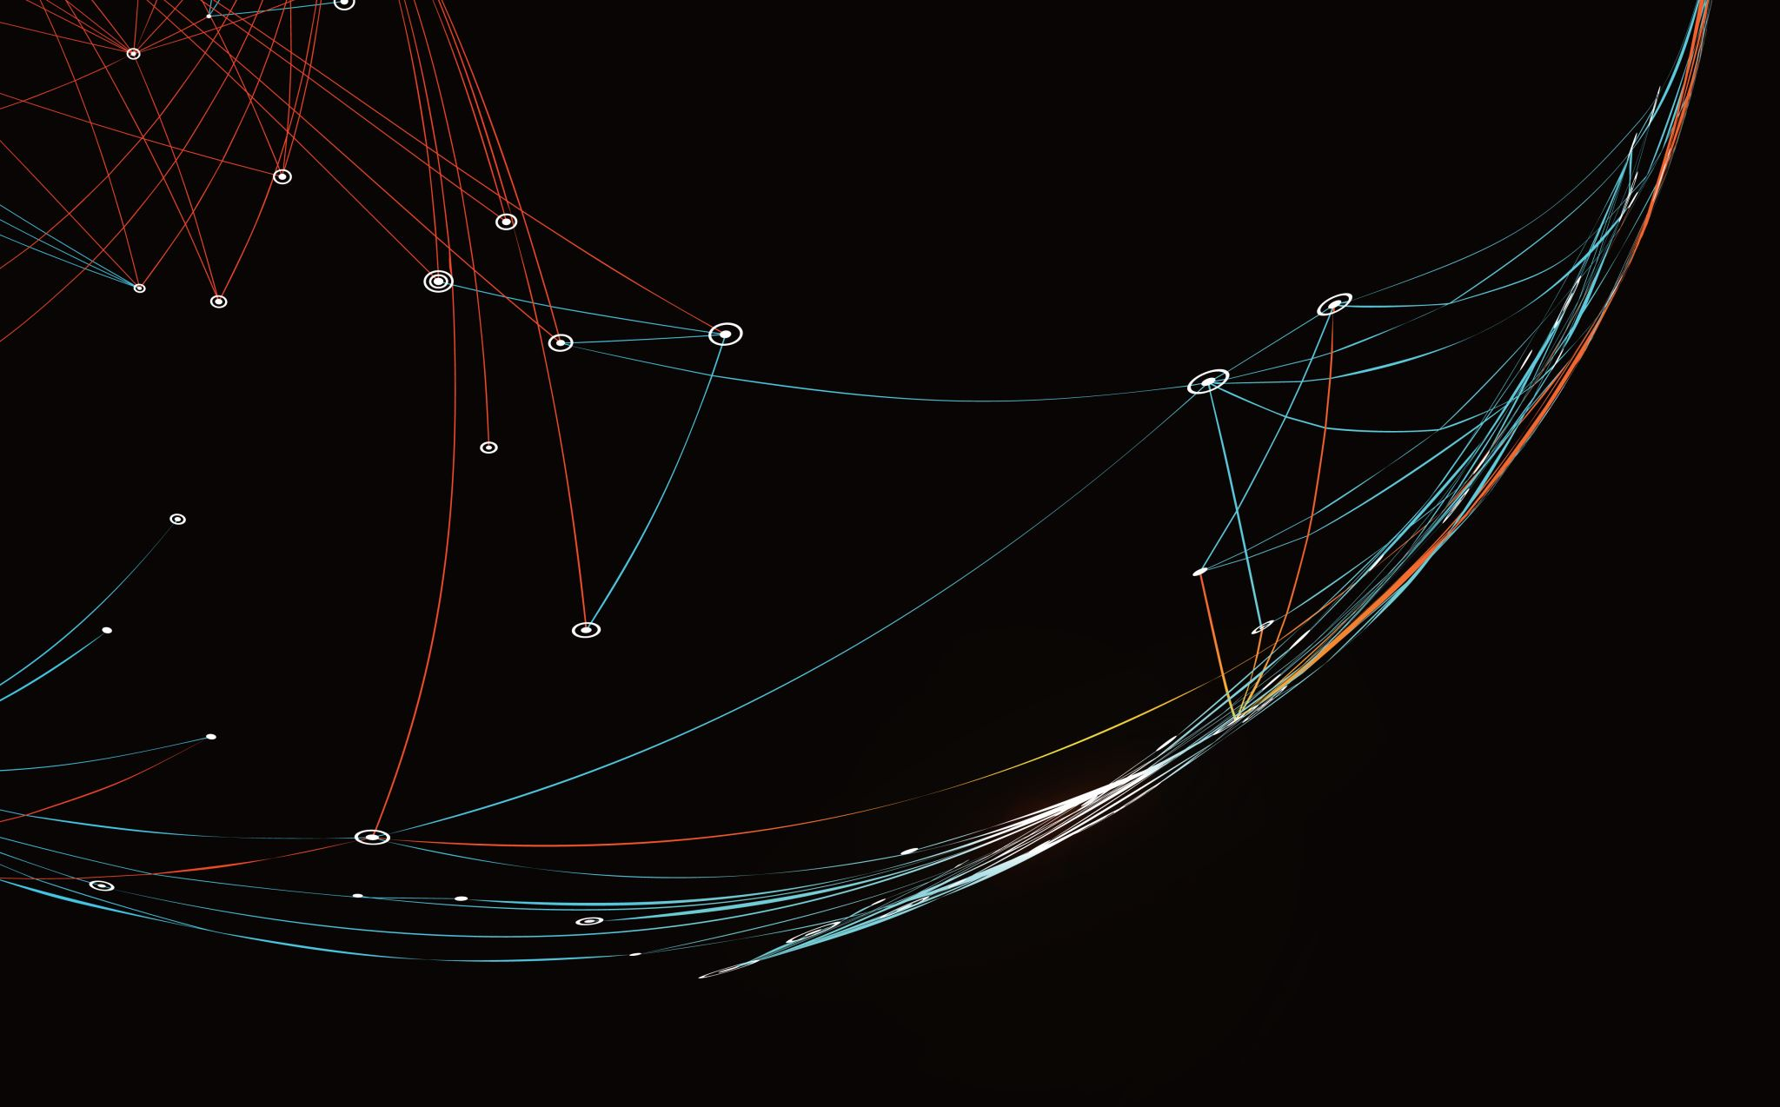
Security Assessment and Risk Management
Week 1 – Vulnerabilities, Risks, and Threats

Slide 2
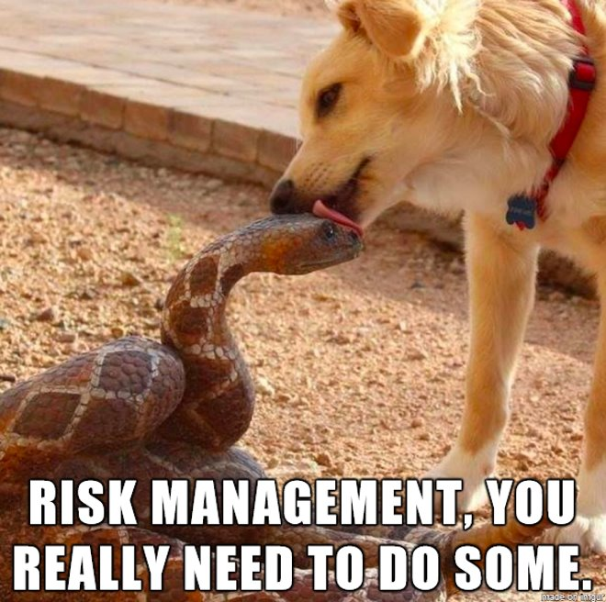
Risk Management
The possibilities for disaster and data theft are infinite in cyberspace.
Cyberspace has become the public forum for social, political, and economic discourse.
Organizations must operate in cyberspace to engage with customers and partners in those spaces. This brings organizations into contact with that risk.
To secure operations in cyberspace, risk managers and organizations must think through, select, and implement a customized risk management plan and continuously monitor the plan’s successes and failures.

Slide 3
Anecdotal Apathy
When I was first starting out in information security I had the same thoughts most green analysts have
There are so many threats, we have to make things are as secure as possible;
Then there this security hole, and this flaw, and this and that and any time I’m not actively configuring a security system I’m sitting around thinking of threats I’ve overlooked.​
It doesn’t take long to realize this posture is untenable. Security can’t bring things to a grinding halt. Every measure must be weighed against risk. Think about the TSA – Anyone think airport security is good? Anyone think it’s worthwhile? Anyone think it’s fulfilling its purpose?​

Slide 4
Anecdotal Apathy
I received some very good advice from a friend that was a black hat turned white hat. His method of risk management was very simple:
“Is it happening? Could it happen soon? If not – who cares?”
Risk management strategies aren’t quite as simple as that, but for a paranoid, overworked, over-caffeinated new security analyst it was exactly the reality check I needed. You can’t solve all the problems. Trying to do that is likely to be a huge waste of time and money. When you have limited resources, you must pick your battles. Security is a strategy.

Slide 5





Assets/Impact
Notes:
An asset is not just computer systems. It’s property, information, and people as well. It is something that has value, intrinsic or extrinsic, tangible or intangible, that is worth protecting.​

Slide 6
Vulnerabilities
Vulnerabilities are weak spots within your environment and your assets—weaknesses that open you up to potential threats and increased risk.
Unfortunately, an organization can have thousands, often millions of vulnerabilities. Remediating all of them is not feasible.
Only 2%-5% of vulnerabilities are likely to be exploited. Among those, an even smaller percentage are likely to pose an actual risk to your business.

Slide 7
Threats
A threat is something out there in the world that could exploit a vulnerability.
Not every vulnerability has a threat.
Sometimes security researchers discover a flaw in software. Something that could be used nefariously, but for whatever reason it’s never known to be exploited.​

Slide 8
Assets (Impact)
Vulnerabilities
Risks
Threats

Slide 9
Risk
Risk is the potential for loss or damage if a threat exploits a vulnerability that leads to the compromise or destruction of an asset.​
Asset + Threat + Vulnerability = Risk​
Risk is the likelihood that a given threat will exploit a particular vulnerability and the resulting consequence of that negative incident occurring.
The property, person, or activity facing a potential loss is known as risk exposure.
Notes:
If you have a computer system with little value, it will be less risky if you discover a vulnerability and threat. A more valuable asset might carry more risk, even if it has a comparably less serious threat and vulnerability.

Slide 10
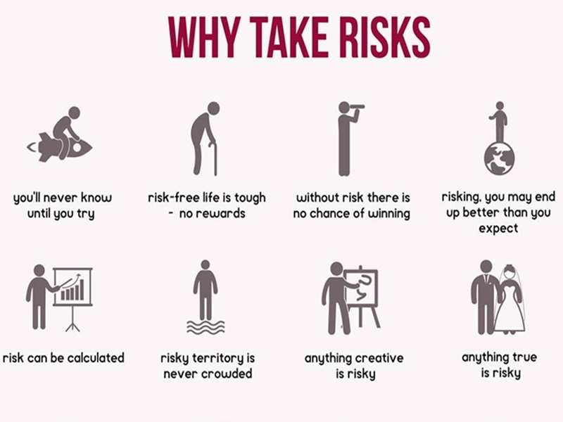
Why Risk?
Organizations take risks.
Gain a commercial advantage
Capitalize on an opportunity
Risk is also pervasive
Value generates risk
We live in a risk-laden world

Slide 11
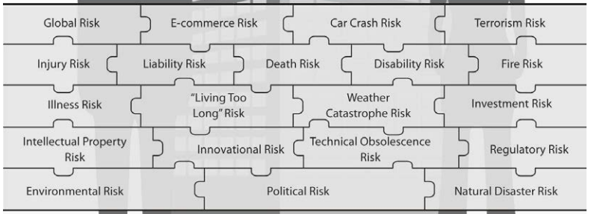
Nature of Risks
Accidental disclosure​
Act of nature​
Alteration of software or data, aka. malware, data breach, etc​
Bandwidth usage – accidental or intentional​
Electrical interference or disruption – power failure, for example​
Configuration error – accidental or intentional​
Telecommunication malfunction – local or remote

Slide 12
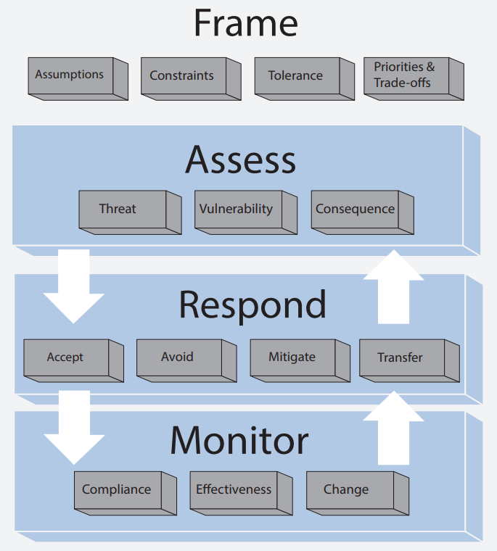
Risk Management
Risk management is a process that formalizes the steps of identifying the most critical assets to an individual, organization, or company; assessing the risk; and determining the best method to prevent harm to these assets.
Risk management permits cybersecurity specialists to weigh technical and financial costs of security measures that support the organization’s function.
Notes:
Some kinds of risk management are intuitive: when you approach a street crossing, you know that you face the risk of being hit by a car. You protect yourself by looking both ways and assessing the situation before deciding how to proceed. Similarly, if you’re deciding whether to come down from a tree by jumping or using a ladder, you consider the potential consequences of each choice and minimize the possibility of bodily harm by opting for the ladder.
In neither of these intuitive examples is the process formalized. Both examples lack (and do not require) a thoughtful and systematic approach to the process of protecting the most critical asset at stake, your physical health.
In contrast, risk management as a professional practice follows a codified process.

Slide 13
Enterprise Risk Management (ERM)
Identifying risk – evaluating the organization’s environment to identify current or potential risks that could affect business operations
Assess risk – analyzing identified risks to see how likely they are to impact the organization, and what the impact could be
Control risk – define methods, procedures, technologies, or other measures that can help the organization mitigate the risks.
Review controls – evaluating, on an ongoing basis, how effective controls are at mitigating risks, and adding or adjusting controls as needed.

Slide 14
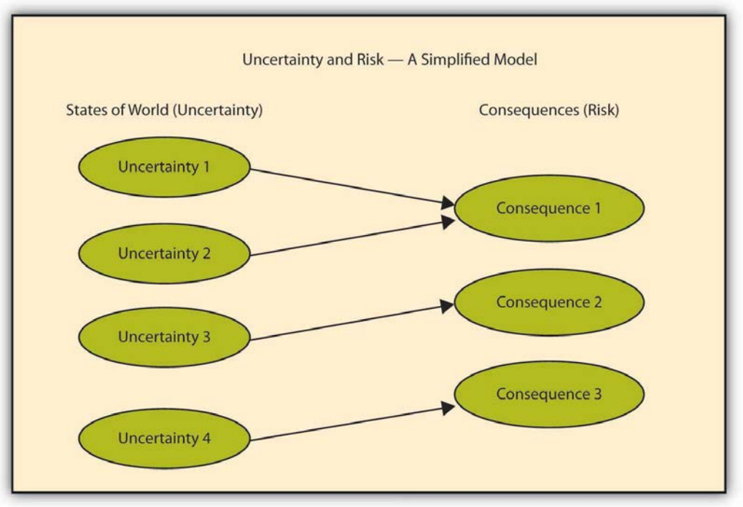
Uncertainty is the Root of Risk
States of the World — Uncertainty | Consequences—Risk
Could or could not get caught driving under the influence of alcohol | Loss of respect by peers (non-numerical); higher car insurance rates or cancellation of auto insurance at the extreme
Potential variety in interest rates over time | Numerical variation in money returned from investment.
Various levels of real estate foreclosures | Losses from financial instruments linked to mortgage defaults or some domino effect such as the one that starts this chapter.
Smoking cigarettes at various numbers per day | Bad health changes (such as cancer and heart disease) and problems shortening length and quality of life. Inability to contract with life insurance companies at favorable rates.
Power plant and automobile emission of greenhouse gasses (CO2) | Global warming, melting of ice caps, rising of oceans, increase in intensity of weather events, displacement of populations; possible extinction or mutations in some populations.

Slide 15
Risk Motivates
Esteem/
Respect
Humiliation
Pursuit of Comfort
Avoidance of Discomfort
More Freedom
Increased Profits
Less Freedom
Loss of Viability
Acceptance
Value
Rejection
Bankruptcy
Security
Fear

Slide 16
Looking at Risk
Some people are risk averse, some are risk seekers, but most lie somewhere in the middle (a concept of risk neutrality.)
Think about skydiving…
The risk averse would not travel, because the danger is too high.
If the plane were going down, the risk of remaining on board is higher than parachuting, so the risk neutral would jump.
The risk seekers don’t need that excuse and parachute from perfectly good planes.

Slide 17
Diversifying Risk Away
It’s not good for organizations to be too close to either extreme.
Risk neutrality is the goal with most organizations, and this is done by placing the process for decisions in the hands of several people, rather than just one. This is known as diversifying away risk.

Slide 18
Diversifying Risk
Be sure to not get this tripped up with diversifying risk. This means mitigating risk by spreading it out. You are less at risk of being homeless in the event of a fire if you own three homes. You are less at risk of losing your database if you have redundant systems.
Not all risk is diversifiable.
Diversifiable risk is also known as idiosyncratic risk (individual to an organization). Non-diversifiable is known as systemic risk (endemic to the system in which the organization belongs.)

Slide 19
Idiosyncratic vs. Systemic Risk
Diversifiable / Idiosyncratic Risk | Non-diversifiable / System Risk
Reputational | Market
Brand | Regulatory
Credit (at the individual level) | Environmental
Product | Political
Legal | Inflation/Recession
Physical damage (at the individual level) | Accounting
Liability (products, premise, employment) | Longevity (at the social level)
Innovational (technical obsolescence) | Mortality and morbidity (at the global/societal level)
Operational
Strategic
Longevity (at the individual level)
Mortality and morbidity (at the individual level)

Slide 20
Pure vs. Speculative Exposures
Pure Risk
Some chance of loss and no chance of gain (e.g., fire risk, flood risk, etc.)
Speculative Risk
A chance to gain or lose (including investment risk, reputational risk, strategic risk, etc.)
Hedging
Taking actions to reduce or eliminate risk. As in: Hedging bets.
Also known at mitigating, harm reduction, abstraction, or insulating. See: Safety net.

Slide 21
Pure Risk (Loss Only) | Speculative Risks (Win or Lose)
Physical damage to property (fire, flood, weather) | Market (interest, foreign exchange, stock market)
Liability risk exposure (products, premise, employment) | Reputational
Innovational (technical obsolescence) | Brand
Operational (mistakes in process or procedure) | Credit (at the individual level)
Mortality and morbidity risk (at individual level) | Product success
Intellectual property violation | Public relations
Environmental (water, air, hazardous chemicals) | Population changes
Natural disasters | Market for the product
Man-made destruction (nuclear, wars, unrest) | Regulatory change
Mortality and morbidity risks (at the societal level) | Political
 | Investment / Accounting
 | Research and development

Slide 22
Personal Risk
Property Risk
Liability Risk
Exposures that directly impact a person, group, or organization.
Example: Death of employees, damage to brand reputation, etc.
Exposures that directly impact the property of a person, group, or organization.
Example: Theft of computers, storm damaged a building, etc.
Losses that the person, group, or organization is responsible for.
Example: Customer trips, vendor risks, etc.

Slide 23
Catastrophic vs. Particular
Catastrophic risk is a concentration of strong, positively correlated risk exposures, such as many homes in the same location.
Too many eggs in one basket.
Particular risk is a single strong risk, where the loss might be severe, but not catastrophic.
The best egg in a singe basket.

Slide 24
Perils and Hazards
A peril is something that is the cause of a loss. Generally a broad category of action that is a root cause.
For example, a hacker is a threat, but hacking is a peril.
A class-action lawsuit is a threat, but product becoming contaminated and poisoning people is a peril.
A hazard is a condition that exacerbates the trouble of a peril by increasing the frequency or severity of occurrence.
For example, a backup generator reduces the hazard of power loss as a result of a storm because it lessens the severity and frequency (duration) of the outage.

Slide 25
Hazards
Tangible – Real, physical hazards, such as to infrastructure.
Intangible – Non-physical, opinion or attitudes.
Moral hazards – Hazards that involve behavior that can be construed as negligence or that borders on criminality.
Morale hazards - Involve attitudes of carelessness and lack of concern.

Slide 26
Scenario 1
Omer Laskwood, the Senior Network Administrator for a major online retailer, was overheard saying to his co-worker Vince, “We don’t need to do internal network segmentation. The chances of our perimeter being breached is so low and no amount of security can guarantee protection.”
a. What are your feelings about this statement?
b. How does Omer perceive risk relative to his situation?
c. Consider – exposure, threats, perils, and hazards here.?
d. Are there other risks Omer should consider?

Slide 27
Scenario 2
Flatburg, Inc. recently acquired a partner to vertically integrate. Now they will own the diamond mine as well as the distribution chain. Obviously, this means extending their security infrastructure as well. The leadership believes they have two choices. They could extend their current infrastructure (reassign current guards, centrally manage security operations, etc.), or retain local security assets (hire local guards, local management, etc.) Someone suggested a compromise – hire local guards but management them through the central security reporting structure. The executives have yet to make a decision.
a. What questions would you raise?

